Slide 1
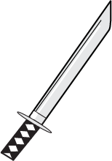
Tumble Rumble
By Team ComputersAreHard
Video Link:
https://www.youtube.com/watch?v=06YS5yEtmi0&feature=youtu.be

Slide 2
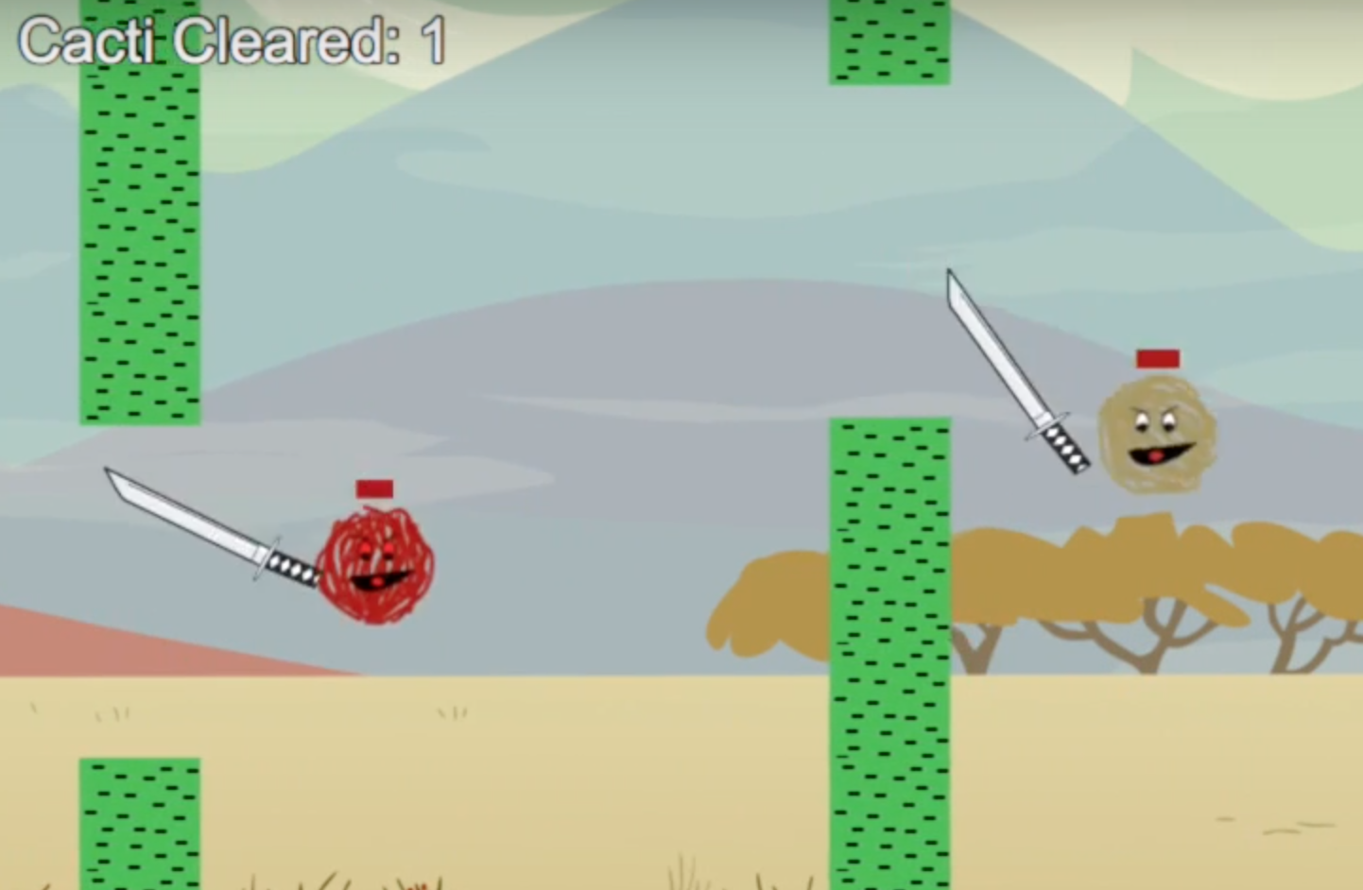
User Experiences of Meaningful Play
Our game is simple and challenging:
The objective is simple: Stay alive by…
Dodging the cactus
Staying in-screen
Avoiding other player’s swords
The challenge: Players are constantly having to maintain focus in order to do so.
One mistake is all it takes to fall behind and die.
This way, our players are engaging in meaningful play by experiencing a game with a clear objective, and their attention and focus is required in order to overcome the challenge.

Slide 3
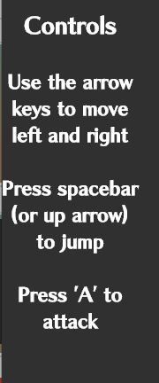

Game Mechanics and their Evolution
Our game mechanics are simple: Players can move with the arrow keys and attack with the “A” key.
Coming in contact with a cactus, or being hit by another player’s sword, will cause the player’s health to decrease.
If a player’s health decreases to 0, they die
Death also occurs if they fall outside of the screen
In the beginning stages of our game, however, our mechanics were not as refined.
Players could hold the jump key and continually move upwards.
Being hit with a sword would kill them instantly
As a result of our User Study, we addressed these issues:
Now, players can only jump once, despite holding down the jump button.
A sword strike will lower their health by 10
The figures above are screenshots from our game’s instruction panel

Slide 4
Software Design
Client
Server
Our game is very client heavy, and our server is extremely light.
Both server and client were written in Javascript.
We used Node.js and Socket.io for Server/Client Interaction, and we used Phaser as our game library.
A couple of primary socket events and their resulting actions:
New player – all clients create a new sprite
Move player – all clients move a certain sprite to a coordinate specified by the event’s data
Damage player – all clients show a sprite has been damaged
Once a client emits an event, the server will then broadcast that event to all other clients, which then update their sprites accordingly.
index.html
Server.js
Player.js
Boot.js
Preloader.js
Menu.js
Lobby.js
Stage.js
Results.js
The figure above depicts the relationship between our client and server. The client has many game states and classes (not all are shown here) while the server only has 2.

Slide 5
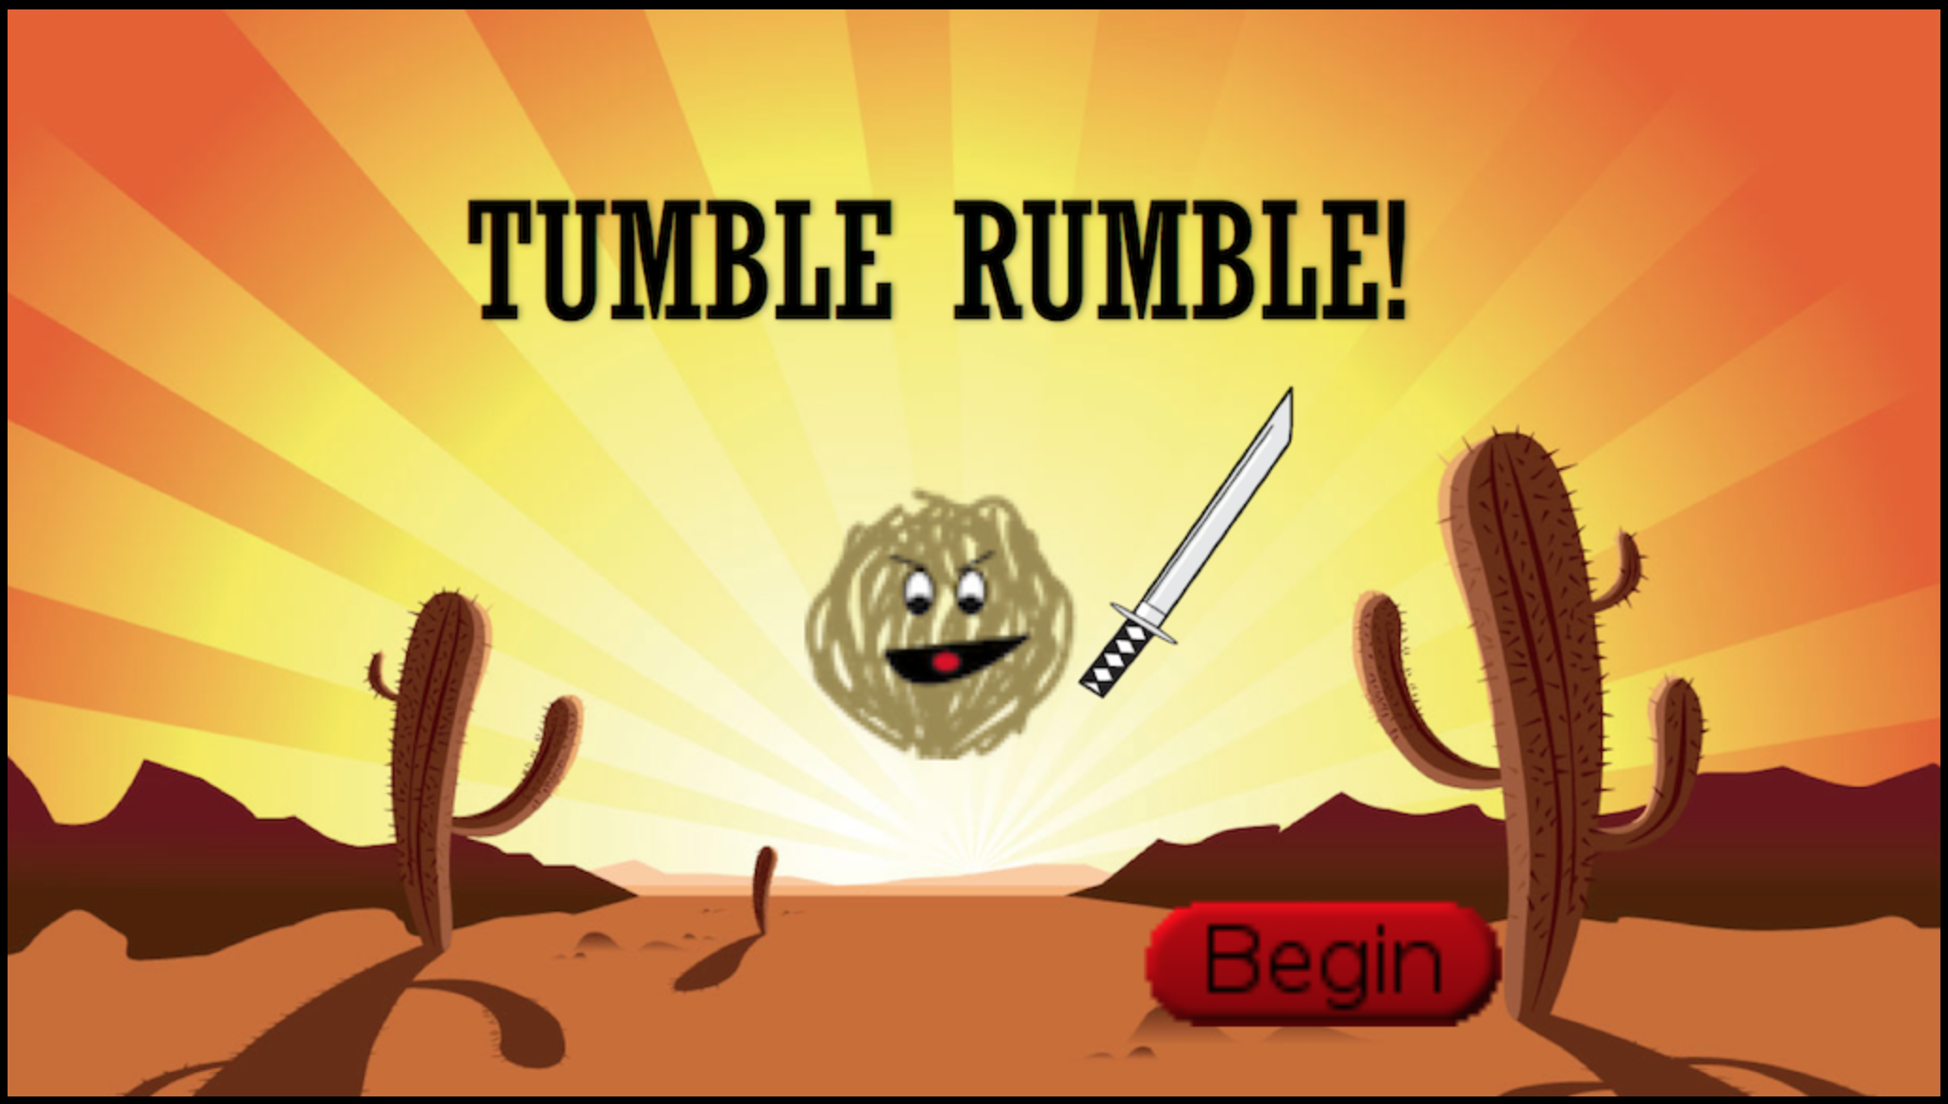

Interface Design
Affordances:
The swords are sharp - Players can assume that hitting other players will
damage them
The cactus walls have gaps in them - Players can assume they are meant to fly through these gaps
Feedback:
Originally, our game had very empty and plain interface (no backgrounds, badly-drawn sprite art)
Backgrounds and improved sprite art were added to accommodate.
User Model:
From our user model, we learned that players wanted an instruction panel
We added this to the index.html so players can always glance over and see it
Visual and Auditory elements conveying game mechanics:
A player that has just taken damage will temporarily flash black
When a match is over, the screen will turn black and tell the players if they won/lost.
Music was added to the Menu, Lobby, and Stage game states for a nicer experience.

Slide 6
Evolution of Ideas
Throughout each deliverable, we learned our game could always be improved.
Our Functional User Study motivates us to drastically change from our original vision:
For the first 4 deliverables, we had a plain fighting game
After our User Study, we wanted to make it more creative and challenging
We dropped our arena-style fighting game and adopted flappy-tumbleweed fighting game.
Added multi-jump mechanic and cactus walls, removed the actual arena
Our software designs also changed:
As time went on, we found more ways to improve our game’s efficiency by restructuring various classes.
Lessened the load on the server by putting as much code as possible into the clients
What we learned as a whole:
Excellent game development requires an agile environment, as we constantly found ourselves needing to add and remove various game elements and attributes.

Slide 7
Thank you for listening!
Credits:
Team ComputersAreHard
Cory Avra
Reed Spivey
Jason Alonzo
Brandon Gann
Any questions?

